Slide 1

Applied Machine Learning & Data Science
Introduction to Python Sridhar Palle, Ph.D

Slide 2
My Background
Technical Director, Consort Institute, Emory Continuing Education, Emory University (2018 - Present)
Assistant Professor of Mechanical Engineering (2016 – 2018), Kennesaw State University
Senior Computational Research Scientist (2009-2016), Northrop Grumman Center for High Performance Computing, Jackson State University, Jackson, MS
Senior CAE Analysis Engineer (2007-2009), Delphi Automotive Corporation, Dayton, OH
Ph.D. from Clemson University (2006), Clemson, South Carolina

Slide 3
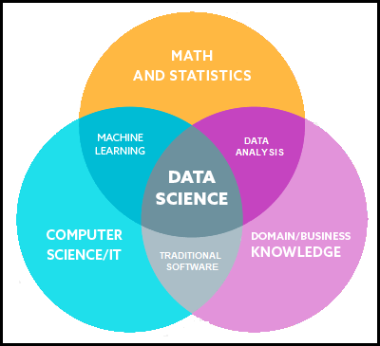
Data Science and Data Analytics
Data science is an interdisciplinary field that employs analytical tools in extracting actionable insights from large volumes and varieties of data to improve the processes and decision making
Data science is multidisciplinary since it encompasses several other disciplines
Statistics and Math
Programming
Data visualization
Machine Learning, AI
Distributed, & Cloud computing
Data Analytics is similar to Data science, but is typically thought of being narrower in focus
Notes:
Volume and velocity of data is surpassing human intervention

Slide 4
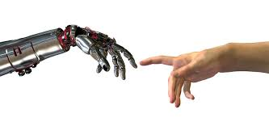
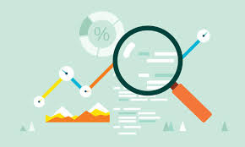

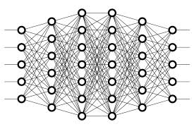
Relation between AI, ML, Data Science?

Slide 5
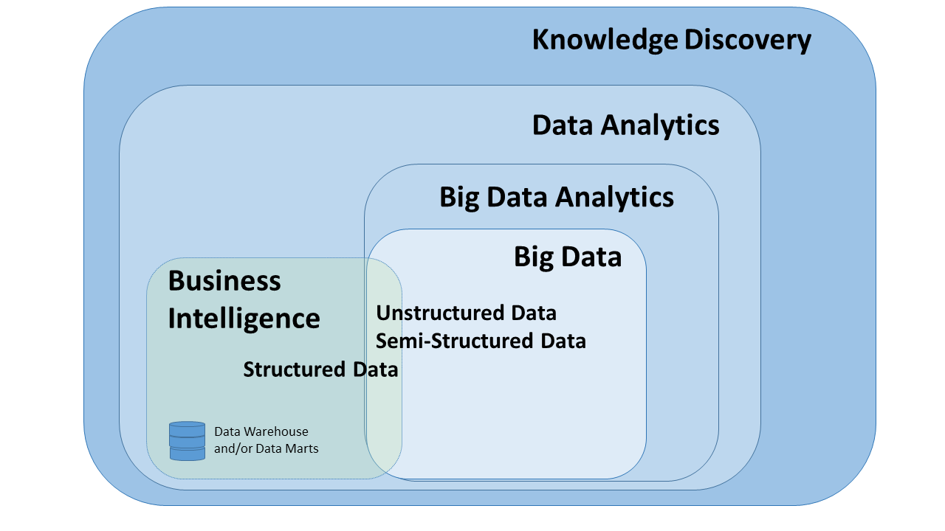
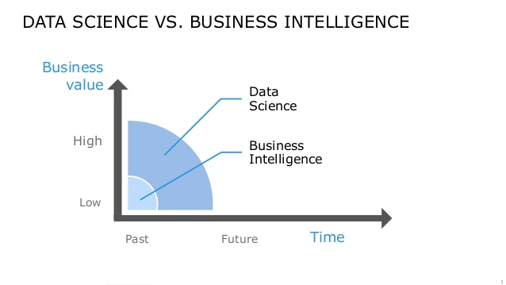
What about BI vs Data Science
Notes:
Business Intelligence is required to operate the business while Business Analytics is required to transform the business.”.. Vice President of Engineering, Noetix Products, Magnitude Software, Pat Roche
Data Analytics is a greater and more valuable proposition than that offered by traditional BI, which relies too much on the centralisation of data in a singular data warehouse. In contrast, DA offers organisations greater flexibility, pulling in information from a variety of fragmented and disparate sources.

Slide 6
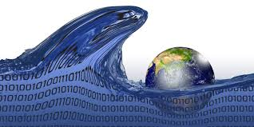
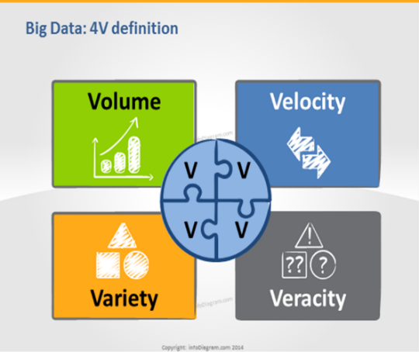

Need for Data Science & ML?
Why now?
Deluge of data from all connected devices
Advances in computational hardware
Advances in AI/ML methodologies
Value & Significance
The speed with which organizations can now collect, analyze, and respond to data in real time is unprecedented
Data abundance has opened up novel approaches to decision making in a world where consumer views, competitors stance, data quality, variety, and quantity evolve constantly
Organizations need to quickly adapt to this technology shift or risk becoming obsolete
Notes:
Most of health care data is static. (x-rays, lab results, images, reports etc..). But with data which requires regular monitoring such as multiple daily diabetic glucose measurements, bp redings, operating room monitors can mean the difference between life and death.

Slide 7

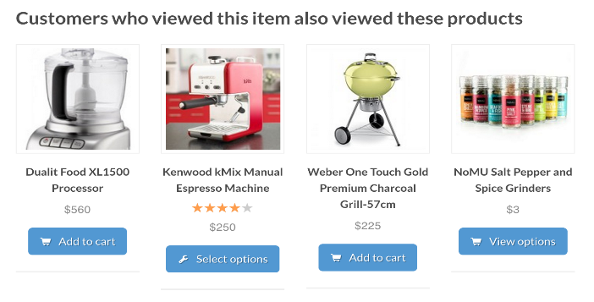
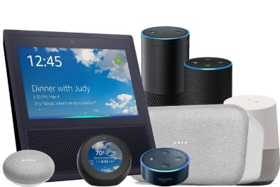
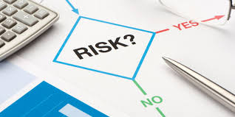
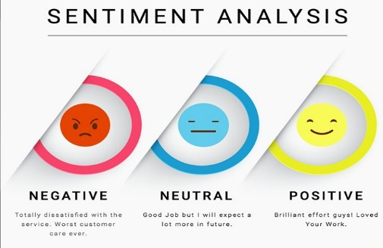
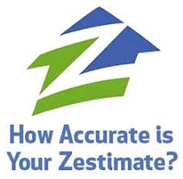
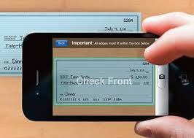

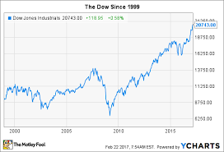

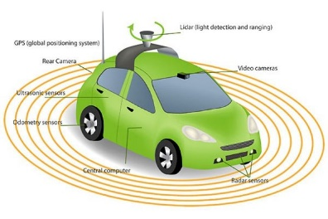
What about applications?:
Healthcare
Advertising, Sales & marketing
Insurance
Finance
Law
Cybersecurity
Automotive Industry
Notes:
Healthcare: Disease detection. Based on patient medical history data (like chol, weight, bp, glucose), cancer, diabtes, heart, NBS program
Advertising Sales & Marketing: Customers who bought this, also bought this. Clubbing of news articles..
Insurance: Risk assessment before insuring, Fraud detection, Claims prediction, Price Optimization, Cutomer segmentation
Finance: Stock market prediction..
Automotive: product quality and recall management, Customer Behavior analytics, Supply chain analytics,
Bottomline. Any field there is a huge amount of data, there is a data science application. Applications only limited by our imagination.

Slide 8
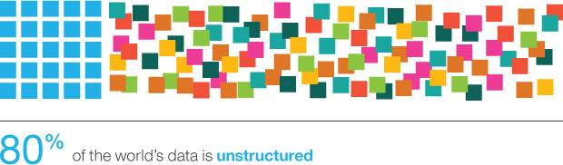

Types of Data
Structured
Tabular data
Excel, RDBMS
Unstructured
Emails, tweets,
Webpages, pdfs, text documents
Video, Audio
Semistructured
Has some structure. Flexible schema
XML, JSON documents

Slide 9
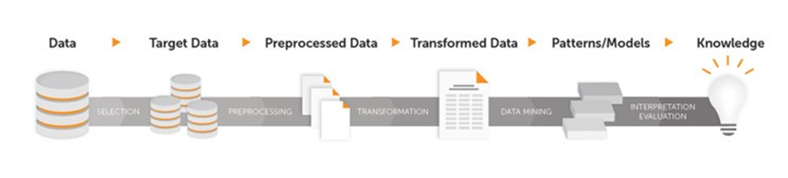
Data Science Procedure
Step 1: | Data Capture & Collection – Data sourcing, integration
Step 2: | Data Visualization/Exploration – Preliminary insight
Step 3: | Data Preparation– Clean/transform
Step 4: | Data Analysis (Modeling) –Apply ML & AI models
Step 5: | Model Evaluation- Evaluate accuracy of model
Step 6: | Predict/Deploy – Apply actionable intelligence gained from the analysis

Slide 10
Machine Learning Techniques
Regression
Predictive (Supervised Learning)
Classification
Machine Learning
Time Series
Association Rule
Descriptive (Unsupervised Learning)
Clustering

Slide 11
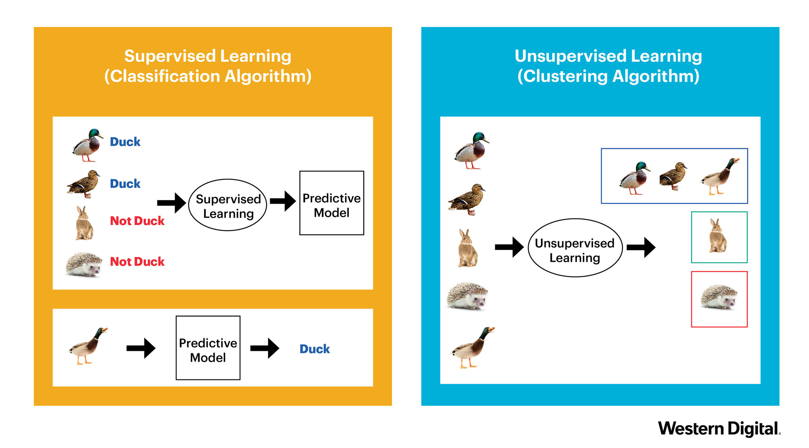
Supervised vs Unsupervised
Labelled Data
No Labelled Data

Slide 12
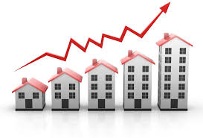
Supervised
Training Data Set
Independent Variables Target ( Label)
Test Data Set
Independent Variables Target ( Label)
Unsupervised
Independent Variables
Sq. feet | Bedroom | Lot size, acre | Pool | Neighborhood | Price
5000 | 5 | 1.2 | Yes | 1 | 350,000
3200 | 3 | 0.6 | No | 4 | 285,000
4600 | 4 | 0.9 | Yes | 2 | 495,000
Sq. feet | Bedroom | Lot size, acre | Pool | Neighborhood | Price
3400 | 3 | 0.75 | No | 1 | ????
Sq. feet | Bedroom | Lot size, acre | Pool | Neighborhood
5000 | 5 | 1.2 | Yes | 1
3200 | 3 | 0.6 | No | 4
4600 | 4 | 0.9 | Yes | 2
Notes:
Data Set: a collection of data with defined structure. This table is a data set with defined structure of 7 rows and 6 columns including column headers.
A record (datapoint) is a single instance in the dataset. Each row in the above table is a record. Each instance has the same structure as the dataset.
An attribute (variable, feature) is a single property of dataset. Each column in the above table is an attribute. Attributes can be numeric, categorical, date-time, or Boolean data types.
A label is a special attribute that needs to be predicted based on all input attributes. In above table, price is the output attribute.
Identifiers are special attributes that provide context to individual records. Names, account numbers, customer id are examples of identifiers.

Slide 13
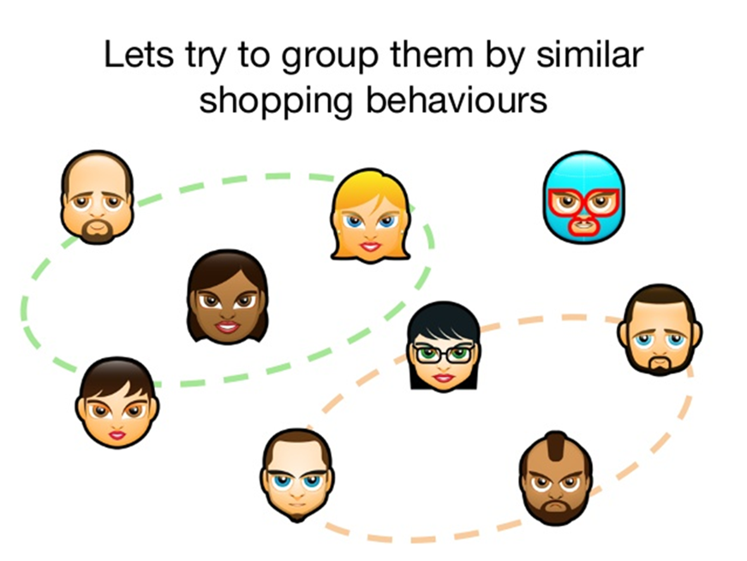
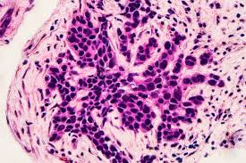
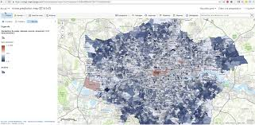
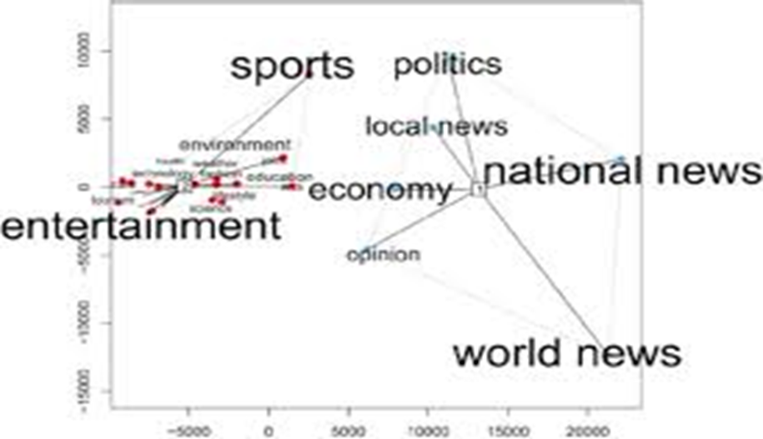

Examples of Supervised & Unsupervised
Predicting House Prices
Customer segmentation
Predicting if a tumor is malignant or not
Predicting crime rates
Classifying news article
Cross-selling or Bundle Pricing

Slide 14
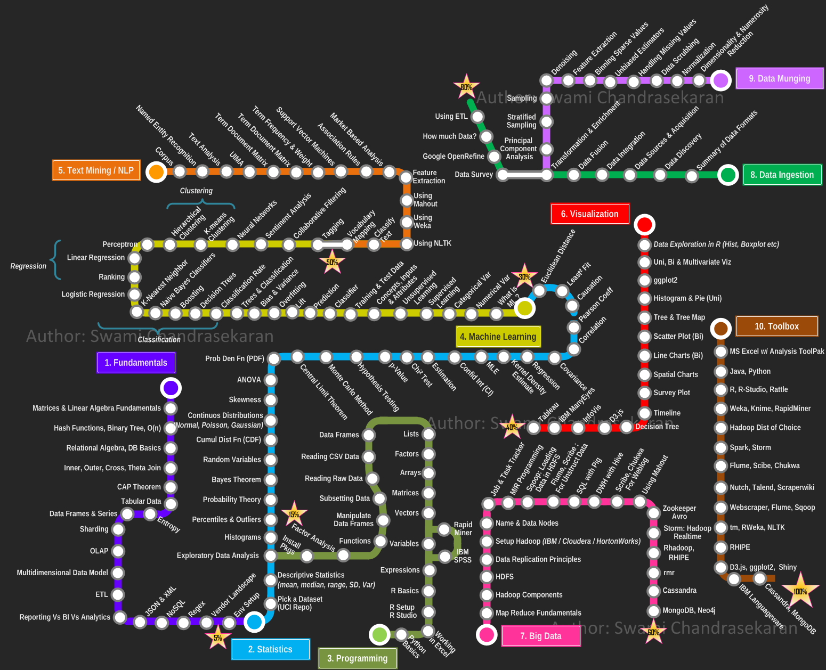
Data Science & ML Journey Map

Slide 15

Python
Python is a high level programming language for general purpose programming
It is created by Guido Van Rossum in 1991
(He was given the post of BDFL by Python community)
Code readability is emphasized in Python. Simpler, cleaner code.
Zen of Python
Beautiful is better than ugly
Explicit is better than implicit
Simple is better than complex
Complex is better than complicated
Readability counts
Notes:
Several applications: Web applications, scientific computing, gaming, education, data science, software development

Slide 16

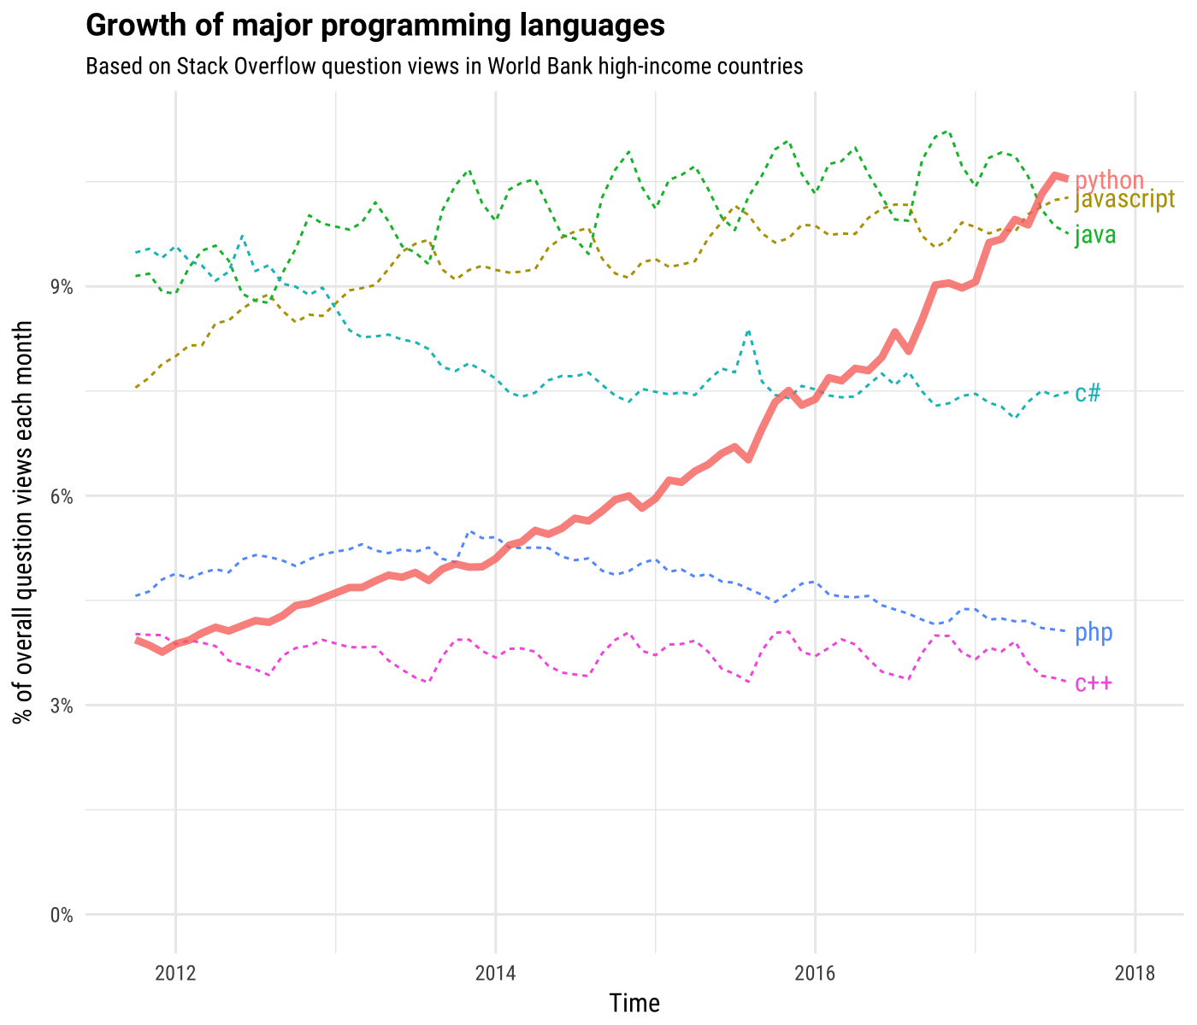
Demand for Python
PYPL Most Popular Programming Language
Source: StackOverflow

Slide 17
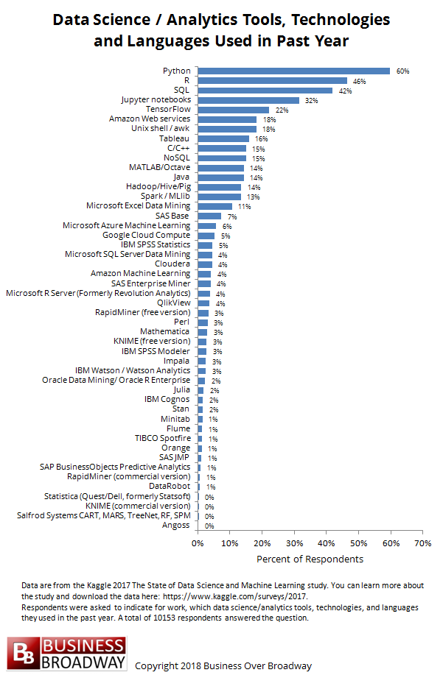

Slide 18
Python Applications
1. Data Science
2. Web Applications
3. Gaming
4. Education
5. Software development
6. Business Applications

Slide 19
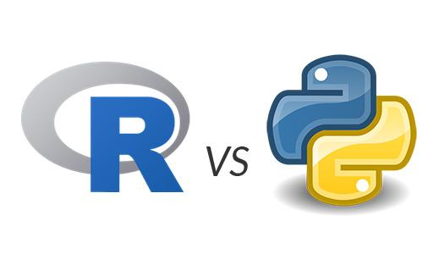
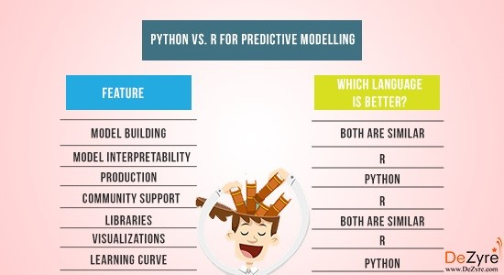
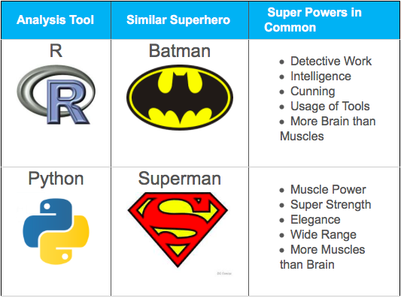
Ucanalytics.com
R is good for ad hoc analysis and exploring datasets, while Python is better for data manipulation and repeated tasks, – Quartz.com Former Data Editor Chris Groskopf
https://www.orison.biz/blogs/ch3ckmat3/2015/06/r-vs-python-for-data-science/

Slide 20
Python pros/cons
Pros | Cons
Readability, simplicity, learning curve is easy. Easy to code and debug. Less time coding and more time playing. | Visualization Capabilities
General Purpose Programming Language. Production ready language. | Slower
Typically preferred by programmers and developers.
Great community support.
Open-Source! Free! ☺
Source: datacamp
Notes:
Python typically used when data analysis tasks need to be integrated with web applications.

Slide 21



Tools to learn Python
Jupyter (Ipython) Notebook
IPython provides a rich architecture for interactive computing with:
A web application that allows you to create and share documents that contains live code, equations, visualizations and explanatory text.
Spyder
Spyder is an open source cross-platform integrated development environment (IDE) for scientific programming in the Python language

Slide 22





Python – Data Science/ML - Ecosystem
Core Python :
Data Structures: Strings, Lists, Dictionaries, Tuples, and Sets
Conditions: if else statements
Automate stuff: For loops, while loop etc..
Wrangle with Data:
Numpy arrays
Pandas Series & DataFrames
Visualize Data: Matplotlib and Seaborn
Machine Learning: Scikit-Learn
Natural Language Processing: NLTK
Seaborn

Slide 23
Words of Wisdom
Being an effective practitioner of data science is less about memorizing the tool or command you should use for every possible situation and more about learning to effectively find the information you don’t know…
Practice is the key for learning any programming language. It builds muscle memory.
One can spend an entire lifetime learning all the intricacies of Python and details of programming. But this is not very productive. Better to first write code that works. Improvements and efficiencies can come later.
Notes:
Most of the times, it is less a matter of knowing the answer as much as “knowing how to quickly find an answer”.

Slide 24
Data Structures
Strings : ‘Python is Amazing!’
Lists : [1,2,3,4] or [a,b,c,d]
Tuples : (1,2,3,4) or (a,b,c,d) or (a,1,2,c,d)
Dictionaries: {‘Angelina Jolie’: 40,‘Tom cruise’:100, ‘Will smith’:70}
Sets: {1, 3, 4, 5}

